Slide 1

IT-648: IT Risk Management
Week 2
Sonja Streuber

Slide 2
Agenda
# | Topic | Reading | Due 11:59 pm CST on Blackboard
3 | System Administration (2): OS Structure, File system | Agrawal 3 Other materials on Blackboard | W: Post F: Responses S: LAB_3

Slide 3
Chapter 3
System Administration (2)

Slide 4
Overview
By the end of this week, you will be able to:
Identify the core components of a modern operating system
Use the command line interface (CLI)
Perform basic operations to navigate the file system
Describe file permissions for users and groups
Perform user account management
Perform software management
Complete the hands-on activities

Slide 5
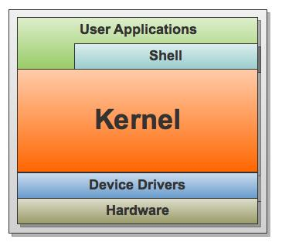
Operating system
Software that manages computer hardware and provides common services to user applications
Shell
Primary interface for system administrators
Direct access to OS structures
Scripting (automation) capabilities
Windows: PowerShell runs as a separate program (Windows 7, Server 2008)
Unix: Ready on OS start-up
Kernel
Controls hardware devices
Manages memory
Executes code on the computer’s CPU
Hides details of underlying physical hardware from applications

Slide 6

Unix Shell History
Name | Developer | 1st Release | Details
Bourne Shell (sh) | Stephen Bourne | 1977 | De facto standard on Unix. Every major Unix-based OS includes at least one Bourne-compatible shell
C Shell (csh) | Bill Joy | 1978 | Syntax is based on the C programming language. Popular for interactive use, but not recommended for use as a general scripting language.
Korn Shell (ksh) | David Korn | 1983 | POSIX 1003.2 compliant, Bourne-compatible and added many features needed for shell scripting.
Bourne-again Shell (bash) | Brian Fox | 1989 | Open-source replacement for Bourne Shell. Very popular for both interactive use and scripting. Combines features from C shell and Korn shell and adds many of its own enhancements. Default shell on Mac OSX and most Linux distributions.

Slide 7
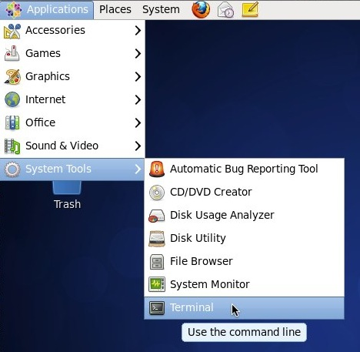
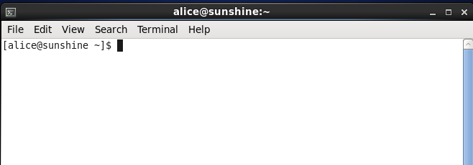
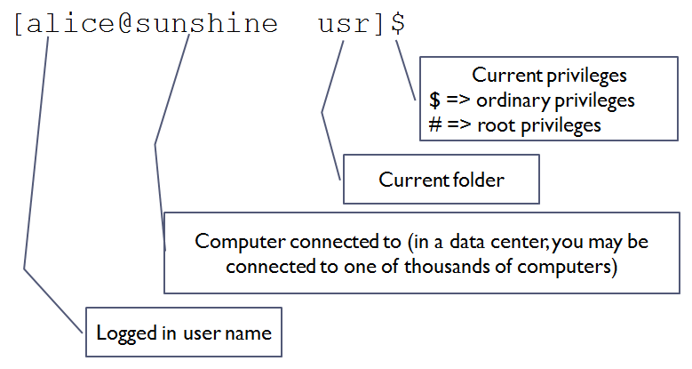
Bash Prompt
Common Operations
File navigation & management
File content viewing and editing
Search
Access control
User management
Access control lists
File permissions
Software installation and updates

Slide 8
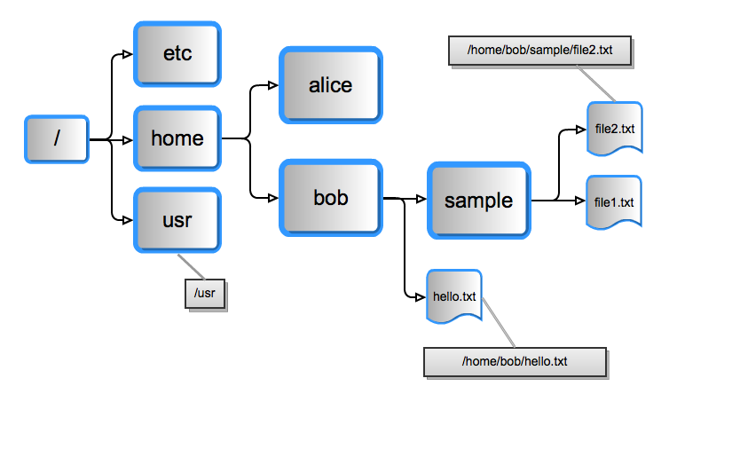
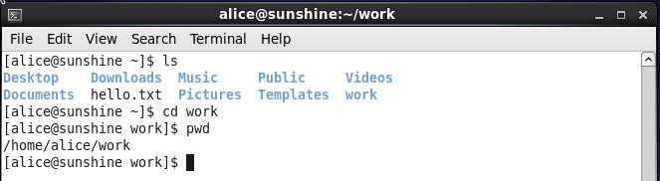
File system navigation
Filesystem root
Top of the file hierarchy
Represented as /
Path
Location of a file or directory in the hierarchy
Relative path
Absolute path

Slide 9
Path representation
Type | Description | Examples
Absolute | Exact location of file or folder being referenced Includes each directory above the final one, up to the file system root | /usr/tmp/hello.txt /home/bob/sample/file2.txt
Relative | Location of the file or folder in relation to the current directory | hello.txt sample/file2.txt

Slide 10
Case sensitivity
UNIX file systems are case sensitive
/usr ≠
/Usr, or
/USR, or
/usR
etc
/home/bob/sample/file2.txt ≠
/home/Bob/sample/file2.txt, or
/home/BOB/sample/file2.txt, or
/Home/bob/sample/file2.txt
etc

Slide 11
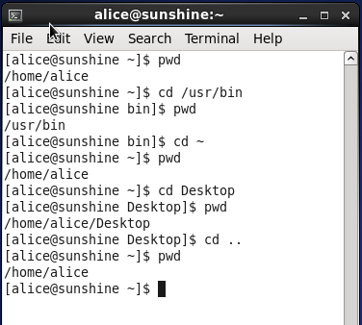
Moving around
pwd
Present Working Directory
e.g.
[alice@sunshine ~]$ pwd
[alice@sunshine ~]$ /home/alice
cd
Change Directory
e.g.
[alice@sunshine ~]$ cd /usr/bin (absolute path specified)
[alice@sunshine bin]$ pwd
[alice@sunshine bin]$ /usr/bin
~ = home directory
.. = folder just above current folder
. = current folder
Notes:
cd – command
/usr/bin – argument
Command
Direction to the computer to perform something
Argument
Relevant information to the computer to help execute the command, e.g. if you want to cd, it helps for the computer to know which folder you wish to go to
Most commands have meaningful defaults, e.g. cd without arguments will take you to your home directory

Slide 12
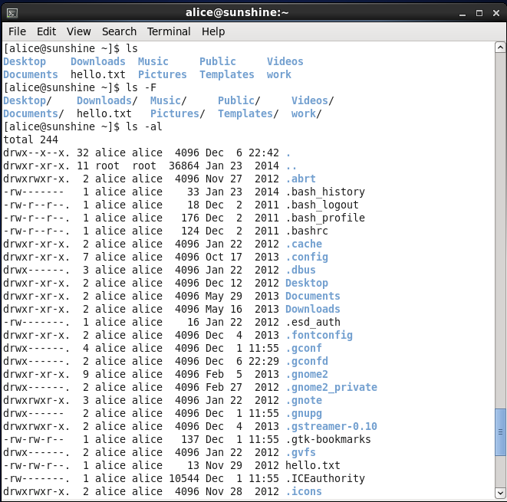
Listing folder contents
ls
[alice@sunshine ~]$ ls
Desktop Documents Downloads hello.txt Music Pictures Public Templates Videos
To distinguish folders from files
[alice@sunshine ~]$ ls -F
Desktop/ Documents/ Downloads/ hello.txt Music/ Pictures/ Public/ Templates/ Videos/
Folders marked by trailing /
ls –al shows long listing with hidden files and folders
Notes:
Options
Indication to the command to behave in a certain way
Modify default behavior of the command, e.g. ls vs ls –F = Show folders in a certain way
Options are also called flags, or switches
Start with a –
No space between – and flag
Usually one letter (e.g. –F), but can be full words (e.g. -debug)
Options can be combined, e.g. ls –f –l
For simplicity, single letter options may be written together, e.g. ls –fl
Most commands have many, many options, e.g. ls
-aAbcCdeEfFghHilLmnopqrRstuvVx1
Some option combinations are very popular, e.g. ls –al
-a: also show hidden files
-l: long listing (show details)

Slide 13
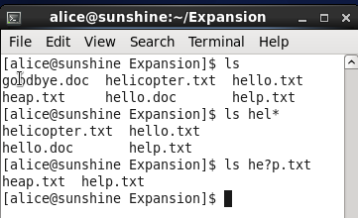
Shell expansions
GUI is convenient
But CLI has its own tricks
Shell expansions (wildcards) simplify command entry
Wildcards
? | Matches any zero or one characters | re?d matches red, reed and read but not reads
* | Matches any zero or more characters | re* matches red, reed, read and reads

Slide 14
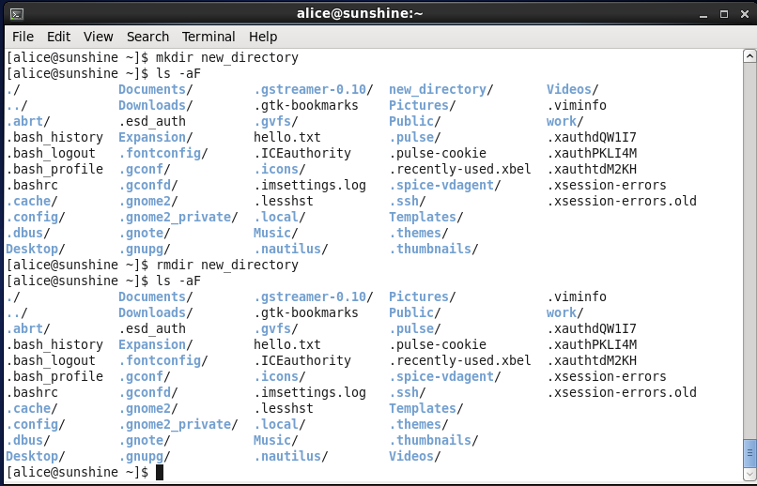
File management
mkdir -- Creates directories
rmdir -- Removes directories
new_directory is gone!

Slide 15
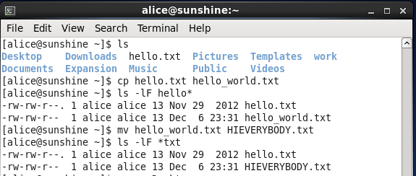
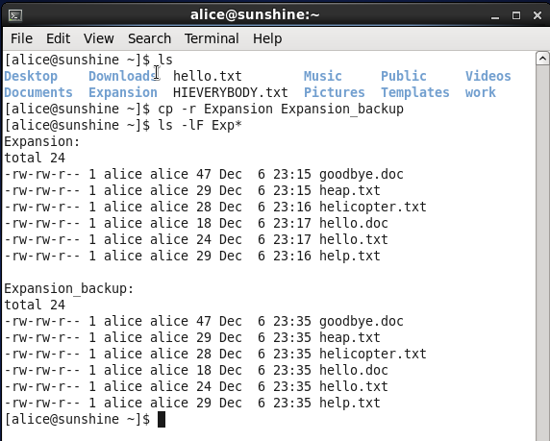
Copying and moving files
General syntax
<cmd> <source> <target>
Copy: cp
Move: mv
Recursion: If folder contains folders and files and folders within those folders
cp only operates at the top level files
mv is always recursive

Slide 16
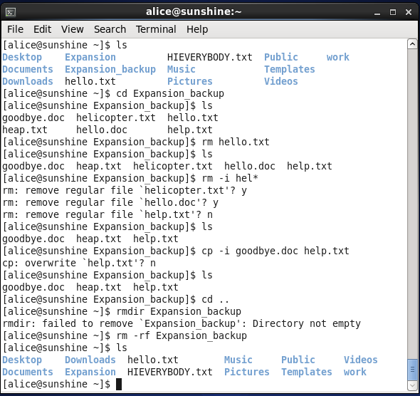
Removing (deleting) files and folders
Remove command
rm
cp, mv and rm are invasive commands
No recovery possible
-i option
Adds interactivity
Warning appears if the operation will delete an existing file
rmdir works with empty folders
rm –r <target> to delete folders with content

Slide 17
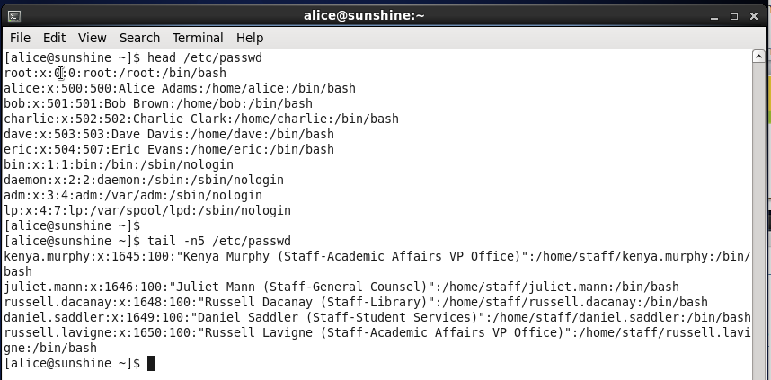
Viewing files
First 10 lines
Last 5 lines
“less” and “more” commands allow scrolling through files

Slide 18

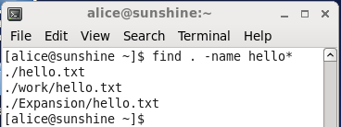
Searching for files
Find
Takes two arguments
Directory to search in
File to look for
Second argument is called an expression
Many operators defined
Type “man find” to see options

Slide 19
Access control
Files need protection
Confidentiality
Safety
End users should not be able to delete server configuration files by accident
File permissions
Very traditional
Universally agreed and standardized
Access control lists (ACLs)
Fine grained
Relatively new and limited tool support

Slide 20
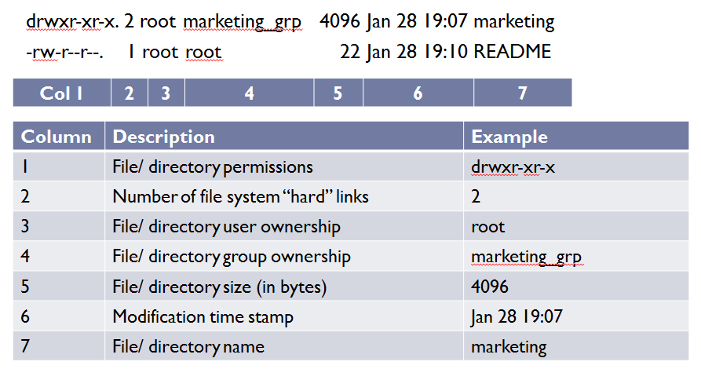
Viewing file permissions (ls –al)
Notes:
In Column 1: First column in ls –al output has 10 characters, e.g. drwxr-xr-x
First character: File type (d = directory, - = file, l = symbolic link)
Remaining 9 characters: File permissions

Slide 21
Permissions
r w x | r - x | r - -
Owner | Group | World
r
Indicates permission to read file (using less, head, tail etc)
w
Indicates permission to edit file (using vi or other editors)
x
Indicates permission to execute file (commands)
e.g.
r w x r – x r - -
Owner can read, write and execute file
Group can read and execute file (but not edit)
Everybody else can only read the file
Notes:
Execute permission for a user is specified by the third character
x indicates execute permission is available
- indicates user/ group/ world cannot execute the file
Other values are possible for this position
s (setuid/ setgid)
File runs with permission of owner/ group, not user executing the file
Often used by developers to simplify testing
Security hazard
T (sticky bit)
Users may write, but cannot move or delete files in this directory

Slide 22
Octal notation
Permissions interpreted as a 3-bit binary number
Read permission = 4
Write permission = 2
Execute permission = 1
Permissions add up
5 = 4 + 1 = Read and execute permission
Equivalent to r-x
Example: 754
Owner: Read, write, execute (4 + 2 + 1)
Group: Read, execute (4 + 1)
World: Read (4)
r | w | x
4 | 2 | 1
r w x | r - x | r - -
Owner | Group | World
7 | 5 | 4
Notes:
644
664
660
777

Slide 23
Changing permissions
What if you want to add or remove permissions
E.g. Group does not have write permissions in Engineering directory
Say we want to allow group members write permissions on the directory
chmod
The chmod command can update permissions on files and folders
Generally requires super user (root) privileges
Owner can also change permissions

Slide 24
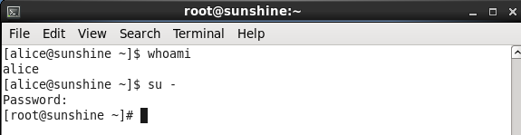
Gaining super-user privileges
su
The su command confers super-user privileges
[alice@sunshine shared]$ su -
Password: EnterTheRootPassword
[root@sunshine ~]#
Note the change in prompt
$ → #
# indicates super-user privileges
System assumes you know what you are doing
Minimal interactivity and confirmations
Be very, very careful at # prompt

Slide 25
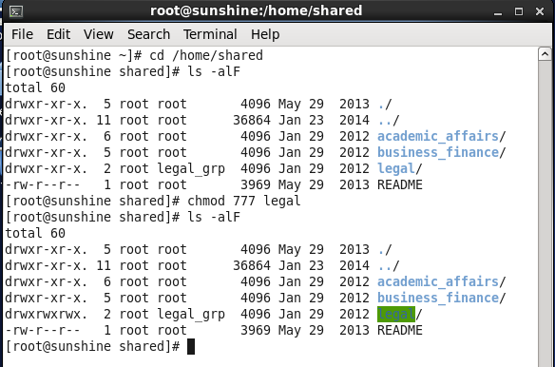
Changing Permissions with chmod

Slide 26
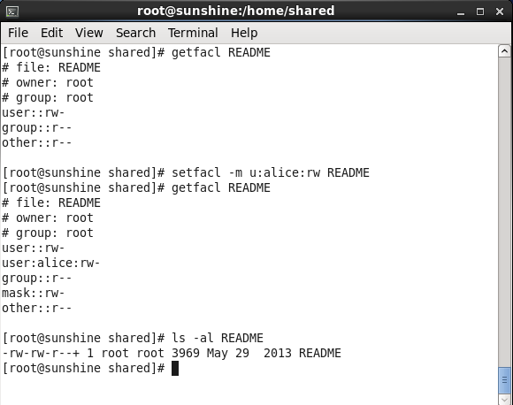
Access control lists
Allow fine-grained application of permissions
getfacl
setfacl
+ shows specific ACL in place

Slide 27
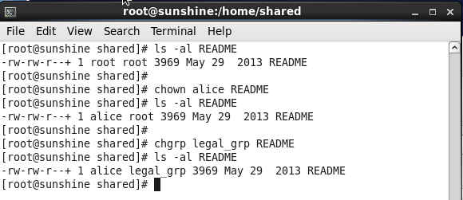
File ownership
chown
Change ownership
chgrp
Change group

Slide 28
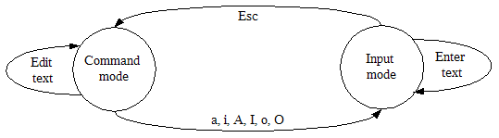
Editing files in vi
Standard editor on all Unix systems
Command mode
User input interpreted as commands, not text input
a, i, A, I, o, O bring vi into input mode
Escape key returns vi to command mode
Input mode
i = insert
a = append

Slide 29
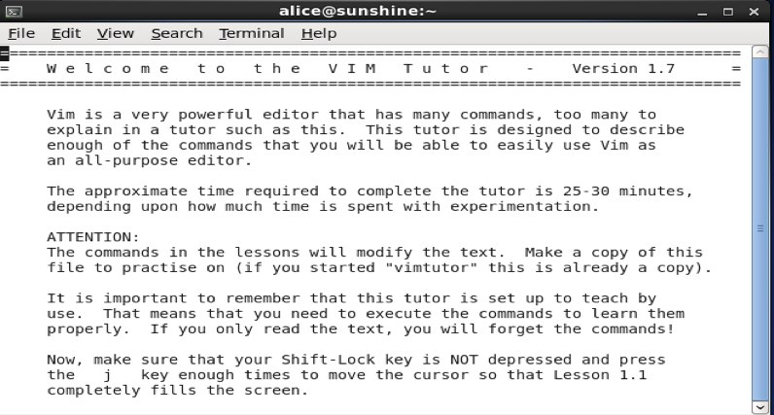
vimtutor
To learn the meanings of a, A, i, I, o, O and the various vi commands, vim has a very user-friendly tutorial called vimtutor
To start vimtutor, use the command
vimtutor

Slide 30
Software install and updates
Linux/ Unix software is often called a package
Refers to all files of the application bundled together as one file
Comparable to .iso files used in Windows software
Software is managed by applications called package managers, e.g.
apt (Debian), rpm (Redhat), pkgutil (Solaris) etc
Our version (CentOS) uses yum
YellowDog Updater, Modified
Open source software is available online
Repositories

Slide 31
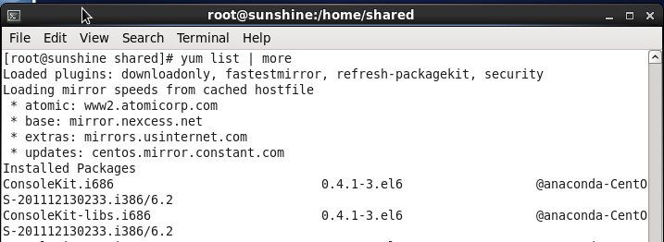
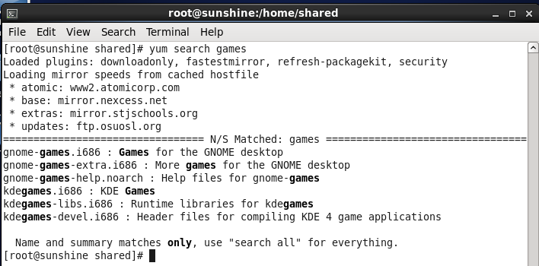
Software search
yum list
yum search <sw>

Slide 32
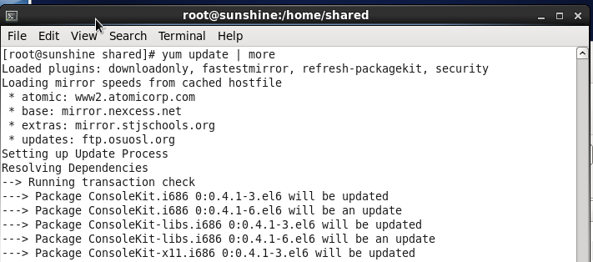
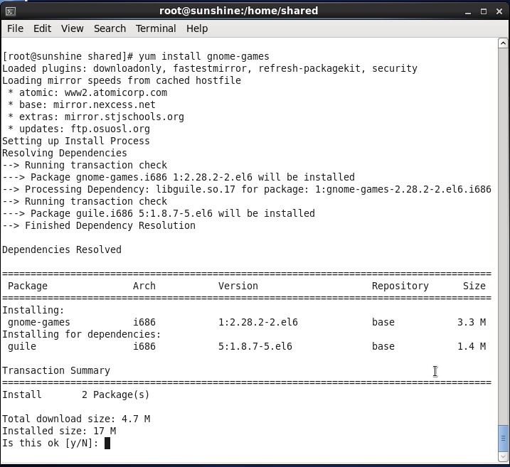
Software installation and update
yum update: Updates all software on the system
yum install <software>

Slide 33
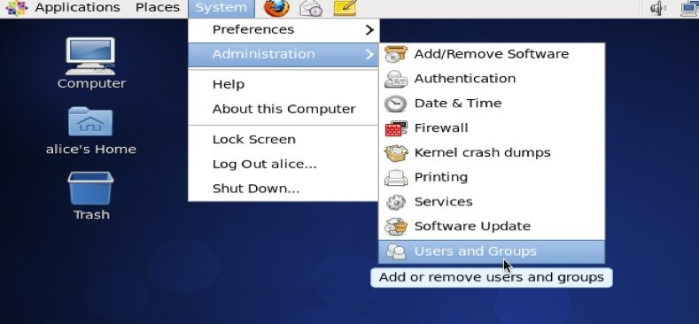
User account management

Slide 34
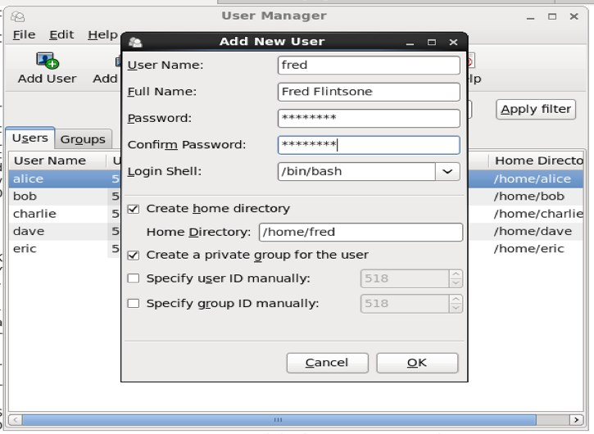
Adding users

Slide 35
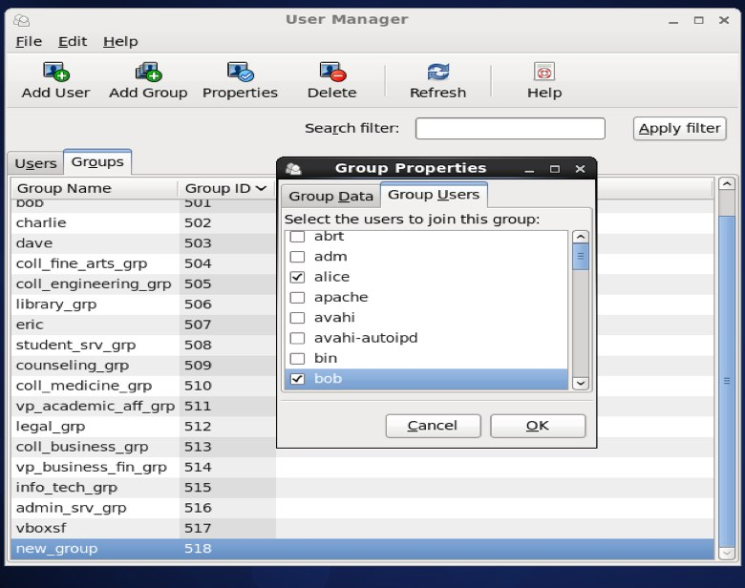
Managing groups

Slide 36
Summary
Operating system structure
Essential system administration
Prompt
File operations
Unix command structure
Wildcards
File navigation
Viewing files
File permissions
Super-user privileges
Editing files
Managing users and groups

Slide 37
Chapter Review Questions
What is the function of the kernel?
What is the shell? What shell program is present in all versions of UNIX? What is a shell prompt?
What is the top of a filesystem hierarchy called? How is it represented in UNIX systems?
What is a path? What is the difference between a rela- tive and absolute path?
What is the pwd UNIX command used for? What are some useful options with the command?
What is the cd UNIX command used for? What are some useful options with the command?
What is the ls UNIX command used for? What are some useful options with the command?
What is the rm UNIX command used for? What are some useful options with the command?
What is the mkdir UNIX command used for? What are some useful options with the command?

Slide 38
Chapter Review Questions
List two commands you could use to change back to your home directory.
What are wildcards (file name expansions)? Provide an example of how you may use one.
What is recursion in the context of file operations? How is it helpful? Why should you be specially careful when using recursion in file commands?
What would be a useful way to use the tail command to view log files?
How would you use the find command to search for the “messages” folder, which you know exists in the /var folder?
Given the following ls –l output, what do you know about the ownership and access permissions for the accounting folder? drwxr-xr-x. 2 root accounting_grp 4096 Jan 28 19:07 accounting/
Given the ls output above, how can you use the chmod command to give write permissions to all members of “accounting_grp” to the “accounting” folder?
What are access control lists? How are they used?
What is the setfacl command used for?
What is the getfacl command used for?

Slide 39
Chapter Review Questions
Why is working knowledge of the vi editor important for IT administrators?
Describe how a setuid executable file behaves when running.
What would the owner of the .bashrc file have to do in order to be able to edit the file if its current permissions are 444?
What is a software package? What are some common formats in which software packages are distributed?
How can you search for all installed software packages on your system?
How can you use the yum command to update all the software on your system?

Slide 40
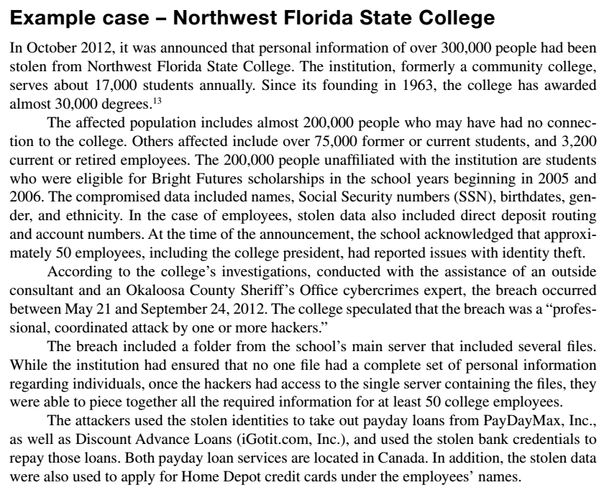

Example case: NWFSC

Slide 41
Example Case Questions
The college maintains a link to a web page detailing the college’s ongoing response to the breach on its home page at http://www.nwfsc.edu/ . Based on that information, what facts can you add to those detailed in the case description provided here?
If your identity is compromised, what damage is possible to your personal life?
What are the recommendations of the Federal Trade Commission (FTC) regarding the steps you should follow if your personal information has been compromised?
What in your opinion are the three most important steps you can take to prevent identity theft in the first place?

Slide 42
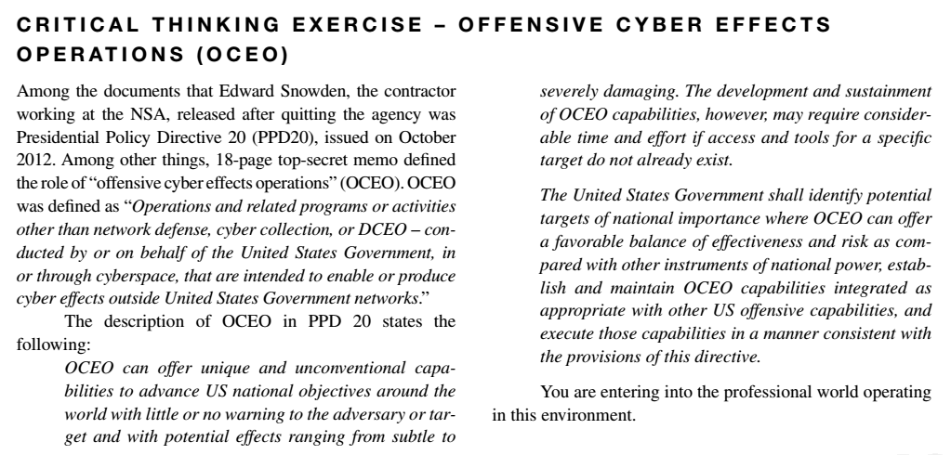
Critical Thinking Exercise

Slide 43
Critical Thinking Exercise Questions
In plain terms, what is OCEO?
What are some activities that may constitute OCEO?
What are some likely repercussions to information security professionals working within the United States (and probably also outside the United States), now that everyone is aware of PPD20?

Slide 44
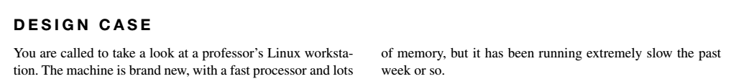
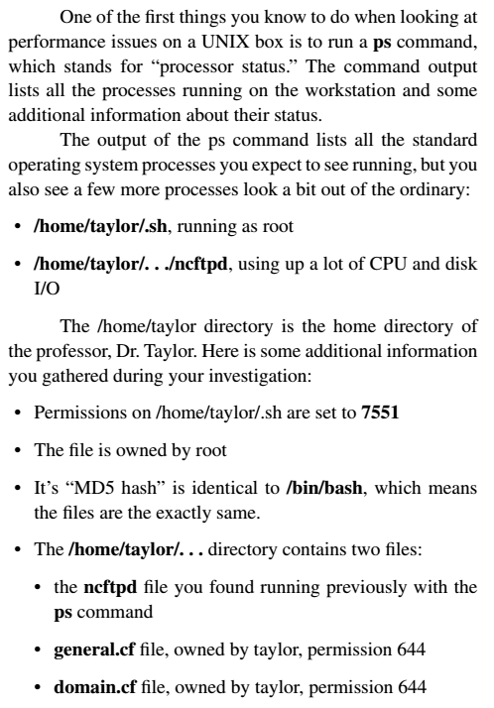
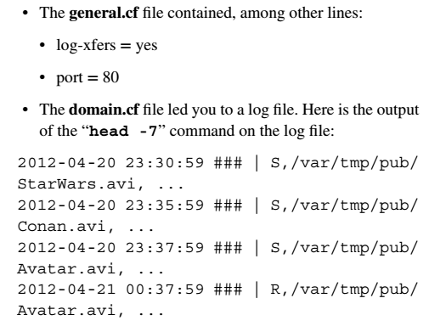
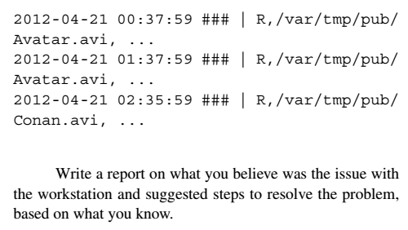
Design Case

Slide 45
Design Case Questions
The workstation was definitely hacked. Dr. Taylor claims he has no idea who put the programs there. There are two differ- ent issues with what you found. One affects the performance of the machine. The other is a bit more serious and should impact your final advice on what to do with the box.
Discuss the .sh program you found in his home directory.
What happens when a “standard” user such as taylor runs that program.
Is a non-administrator user able to change the ownership of a file to root?
Is a non-administrator user able to change the permission of a file to add setuid?
What does that say about the user who put the file there in the first place?
What is the ncftpd program? Do some research on the web if you have to.

Slide 46
Design Case Questions
What do you think was the purpose of the program?
Do you have an educated guess as to when the program was installed or started its operations?
Based on what you know, what should be done with this workstation, and why?
And the bonus questions:
What does the port 80 line in the configuration file mean?
Why was it set that way?

Slide 47
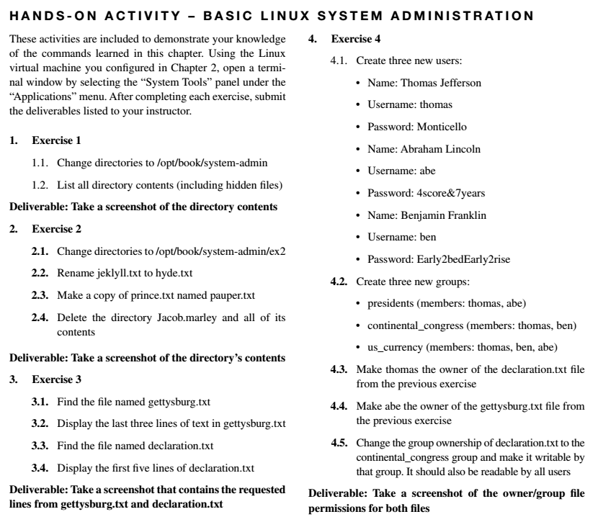
Hands-on Activity

Slide 48
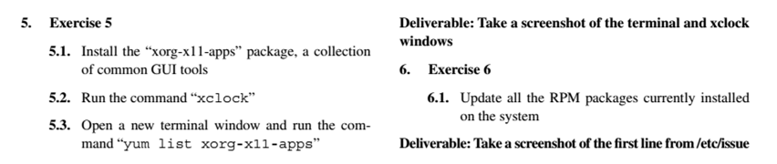
Hands-on Activity

Slide 49
Discussion 3
POST (DUE WED 11:59 pm CST): Pick one of the questions below and post a well-researched answer:
What is Active Directory? What role does it play in main-taining information security on Windows computers?
What are group policies? How do group policies assist system administrators in maintaining information security?
What is a domain controller?
RESPONSE (DUE FRI 11:59 pm CST): Respond to two of your peers' posts and imagine your assigned company. What is the benefit to your corporate users of implementing in your company the item discussed by your peer?

Slide 50
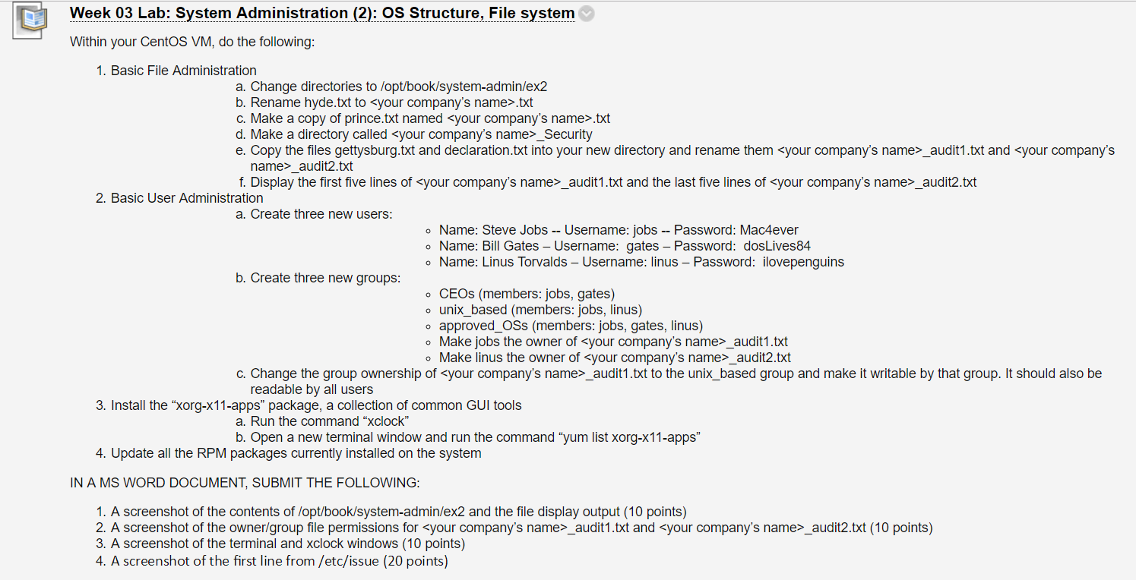
Homework Lab_3

Slide 51
For Next Week
# | Topic | Reading | Due Sunday 11:59 pm CST on Blackboard
4 | The basic information security model: Common vulnerabilities, threats and controls | Agrawal 4 Other materials on Blackboard | W: Post F: Responses S: LAB_4

